Slide 1
Insertion sort
Utegenov Yerzhan
Zhassurbek Boltabayev

Slide 2
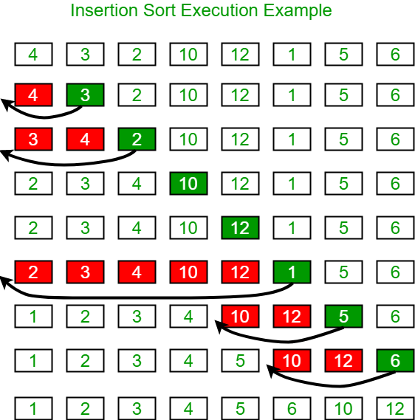
Insertion sort execution example

Slide 3
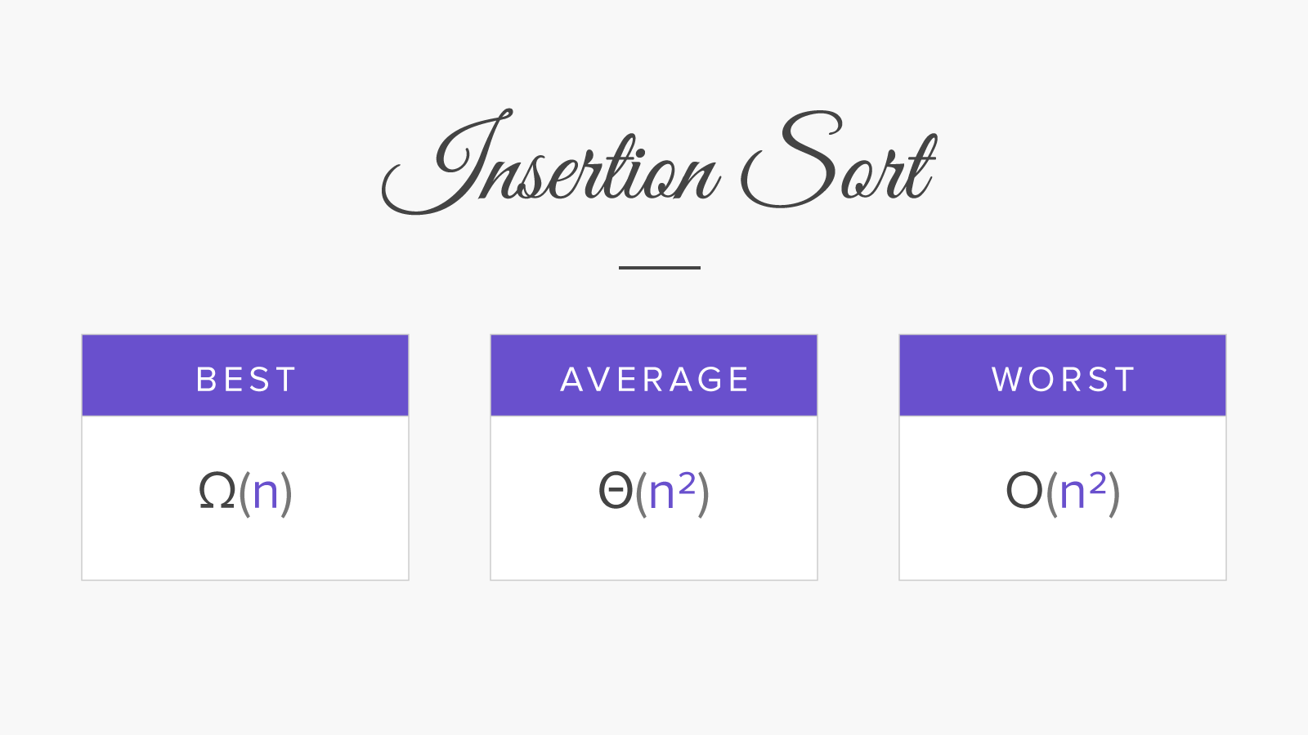
Big O notation
The best case of insertion sort is O(n);
The worst case of insertion sort is O(n^2);

Slide 4
public class Main { static void sort(int arr[]) { int n = arr.length; for (int i = 1; i < n; ++i) { int key = arr[i]; int j = i - 1; /* Move elements of arr[0..i-1], that are greater than key, to one position ahead of their current position */ while (j >= 0 && arr[j] > key) { arr[j + 1] = arr[j]; j = j - 1; } arr[j + 1] = key; } } static void printArray(int arr[]) { int n = arr.length; for (int i = 0; i < n; ++i) System.out.print(arr[i] + " "); System.out.println(); } public static void main(String[] args) { int arr[] = { 12, 11, 13, 5, 6 }; sort(arr); printArray(arr);

Slide 5
